Slide 1
Wireless Authentication Protocols

Slide 2
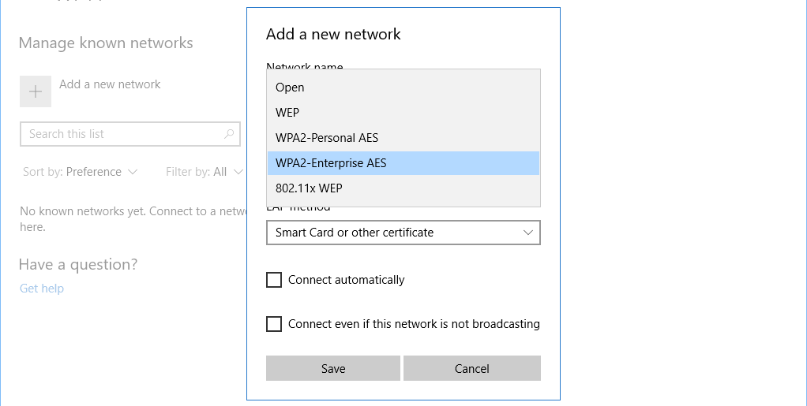
WPA-Enterprise
WPA-PSK is for Personal networks with Pre-Shared Key
Must specify how to authenticate when joining an Enterprise network
EAP is an authentication framework
Not used on its own, EAP is implemented in many ways
Extensible Authentication Protocol

Slide 3
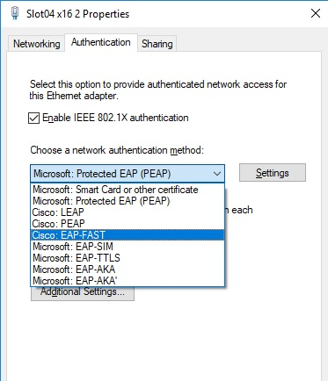
EAP-FAST
EAP Flexible Authentication via Secure Tunneling
Cisco’s replacement for older LEAP (Lightweight EAP)
LEAP was proprietary EAP used with WEP by Cisco
Lightweight and secure

Slide 4
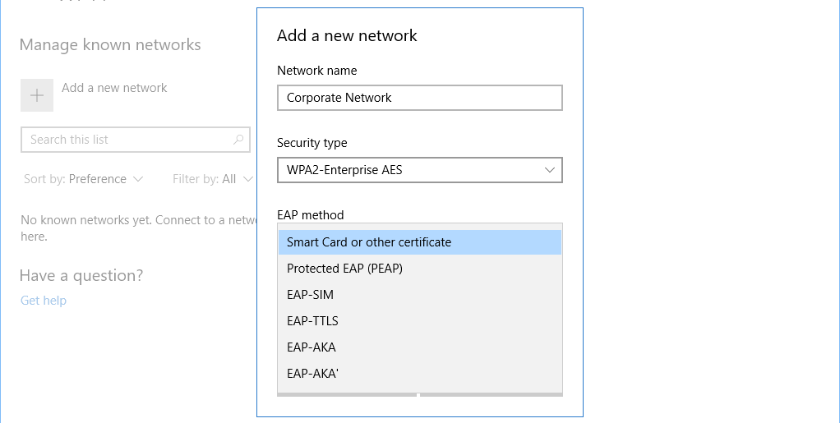
EAP-TLS
EAP Transport Layer Security
Strong security through TLS
Wide adoption
Supported by most of industry

Slide 5
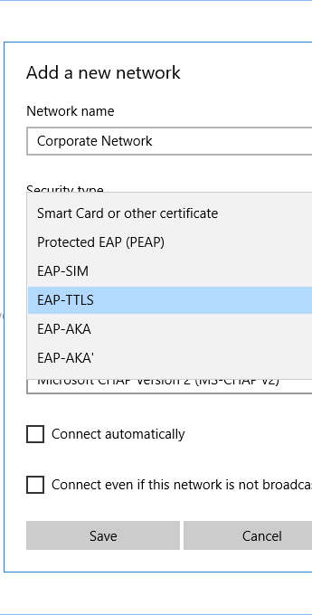
EAP-TTLS
EAP Tunneled Transport Layer Security
Supports other authentication protocols via TLS tunnel
Uses any authentication
Relies on security from TLS

Slide 6
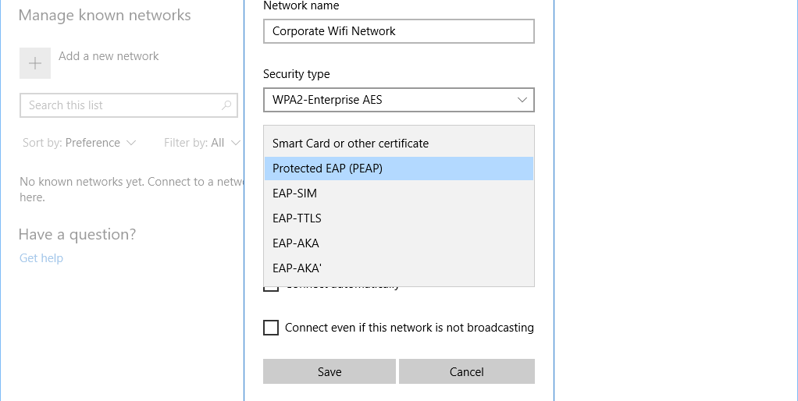
PEAP
Protected Extensible Authentication Protocol
Created by collaboration by Cisco, Microsoft, and RSA Security
Encapsulates EAP in a TLS tunnel, one certificate on the server
Combines secure channel (TLS) and EAP
Authenticates against Microsoft’s MS-CHAPv2 databases

Slide 7

IEEE 802.1X
Port-based Network Access Control (NAC)
Prevents network access until you properly authenticate
Used with an authentication database
RADIUS
LDAP
TACACS+

Slide 8



802.1X
Authenticator
Authentication Server
Supplicant

Slide 9

802.1X
Oh look! A wireless network!
Supplicant
Authenticator
Authentication Server

Slide 10
802.1X
Not so fast. Are you new here?
Supplicant
Authenticator
Authentication Server
EAP Request

Slide 11
802.1X
Yeah. I’m Kevin.
Supplicant
Authenticator
Authentication Server
EAP Response

Slide 12
802.1X
Kevin is out here trying to join.
Supplicant
Authenticator
Authentication Server

Slide 13
802.1X
See if Kevin can communicate privately.
Supplicant
Authenticator
Authentication Server

Slide 14
802.1X
Server wants to talk privately.
Supplicant
Authenticator
Authentication Server

Slide 15
802.1X
Yeah, here’s my login info.
Supplicant
Authenticator
Authentication Server

Slide 16
802.1X
Here’s Kevin’s login info.
Supplicant
Authenticator
Authentication Server

Slide 17
802.1X
Yep. Those check out. Let him through.
Supplicant
Authenticator
Authentication Server

Slide 18
802.1X
Okay, you’re in.
Supplicant
Authenticator
Authentication Server

Slide 19

RADIUS Federation
Federation
Members of one organization can authenticate to the network of another organization
Use their normal “home network” credentials
Use 802.1X as the authentication method
EAP method to authenticate
RADIUS as backend
Created by eduRoam for universities
Allows faculty and staff from one college to authenticate and join network at another college
Imagine neighboring school district coming over and using network

